Slide 1
Design Patterns vs. Anti-patterns in APL: Escaping the Beginner’s Plateau
Functional Conf 2017
Aaron W. Hsu
arcfide@sacrideo.us

Slide 2
Disclaimer

Slide 3
Don’t be fanatical. Enjoy computing. Have fun.

Slide 4
APL

Slide 5
Infamous

Slide 6
Wonderful (?)

Slide 7
Computer Scientists vs. Normal Folk

Slide 8
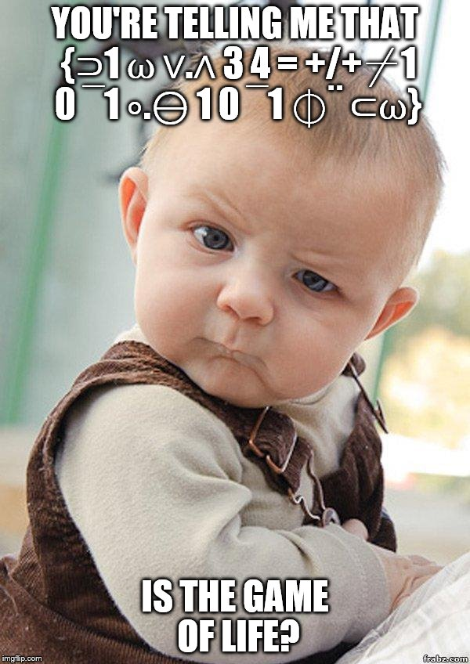

Slide 9
The virtues of APL that strike the programmer most sharply are its terseness — complicated acts can be described briefly, its flexibility — there are a large number of ways to state even moderately complicated tasks (the language provides choices that match divergent views of algorithm construction), and its composability — there is the possibility to construct sentences — one-liners as they are commonly called — that approach in the flow of phrase organization, sequencing and imbedding, the artistic possibilities achievable in natural language prose. -- Alan Perlis, APL One-liners and Lyrical Programming

Slide 10
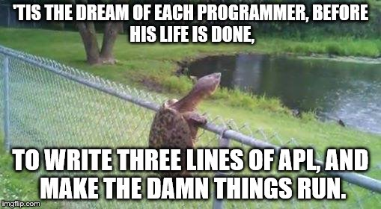

Slide 11
So you want to learn APL?

Slide 12
Game of Life

Slide 13
😖

Slide 14
Emotional Attachment to Engineering

Slide 15
Cult of Best Practices

Slide 16
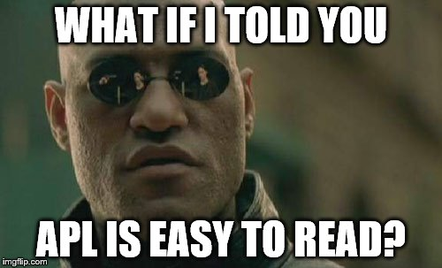

Slide 17
Free Your Mind

Slide 18
By relieving the brain of all unnecessary work, a good notation sets it free to concentrate on more advanced problems, and in effect increases the mental power of the race. -- A. N. Whitehead The quantity of meaning compressed into small space by algebraic signs, is another circumstance that facilitates the reasonings we are accustomed to carry on by their aid. -- Charles Babbage

Slide 19
Ease of Solution Expression Suggestivity Ability to Subordinate Detail Economy Amenability to Formal Proofs

Slide 20


Slide 21
Patterns vs. Anti-patterns

Slide 22
Principle over Prescription

Slide 23
Studies have shown… Miller 1981 Pane 2001

Slide 24
Brevity over Verbosity

Slide 25
+⌿÷≢

Slide 26
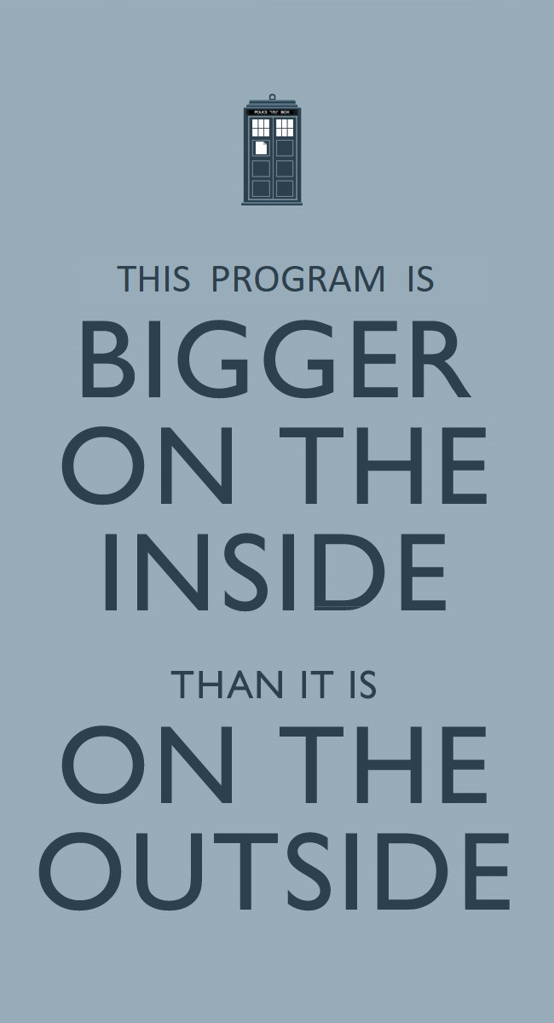

Slide 27
Malleability

Slide 28
Brief Code Fits in Your Brain

Slide 29
And the studies…

Slide 30
Macro over Micro

Slide 31
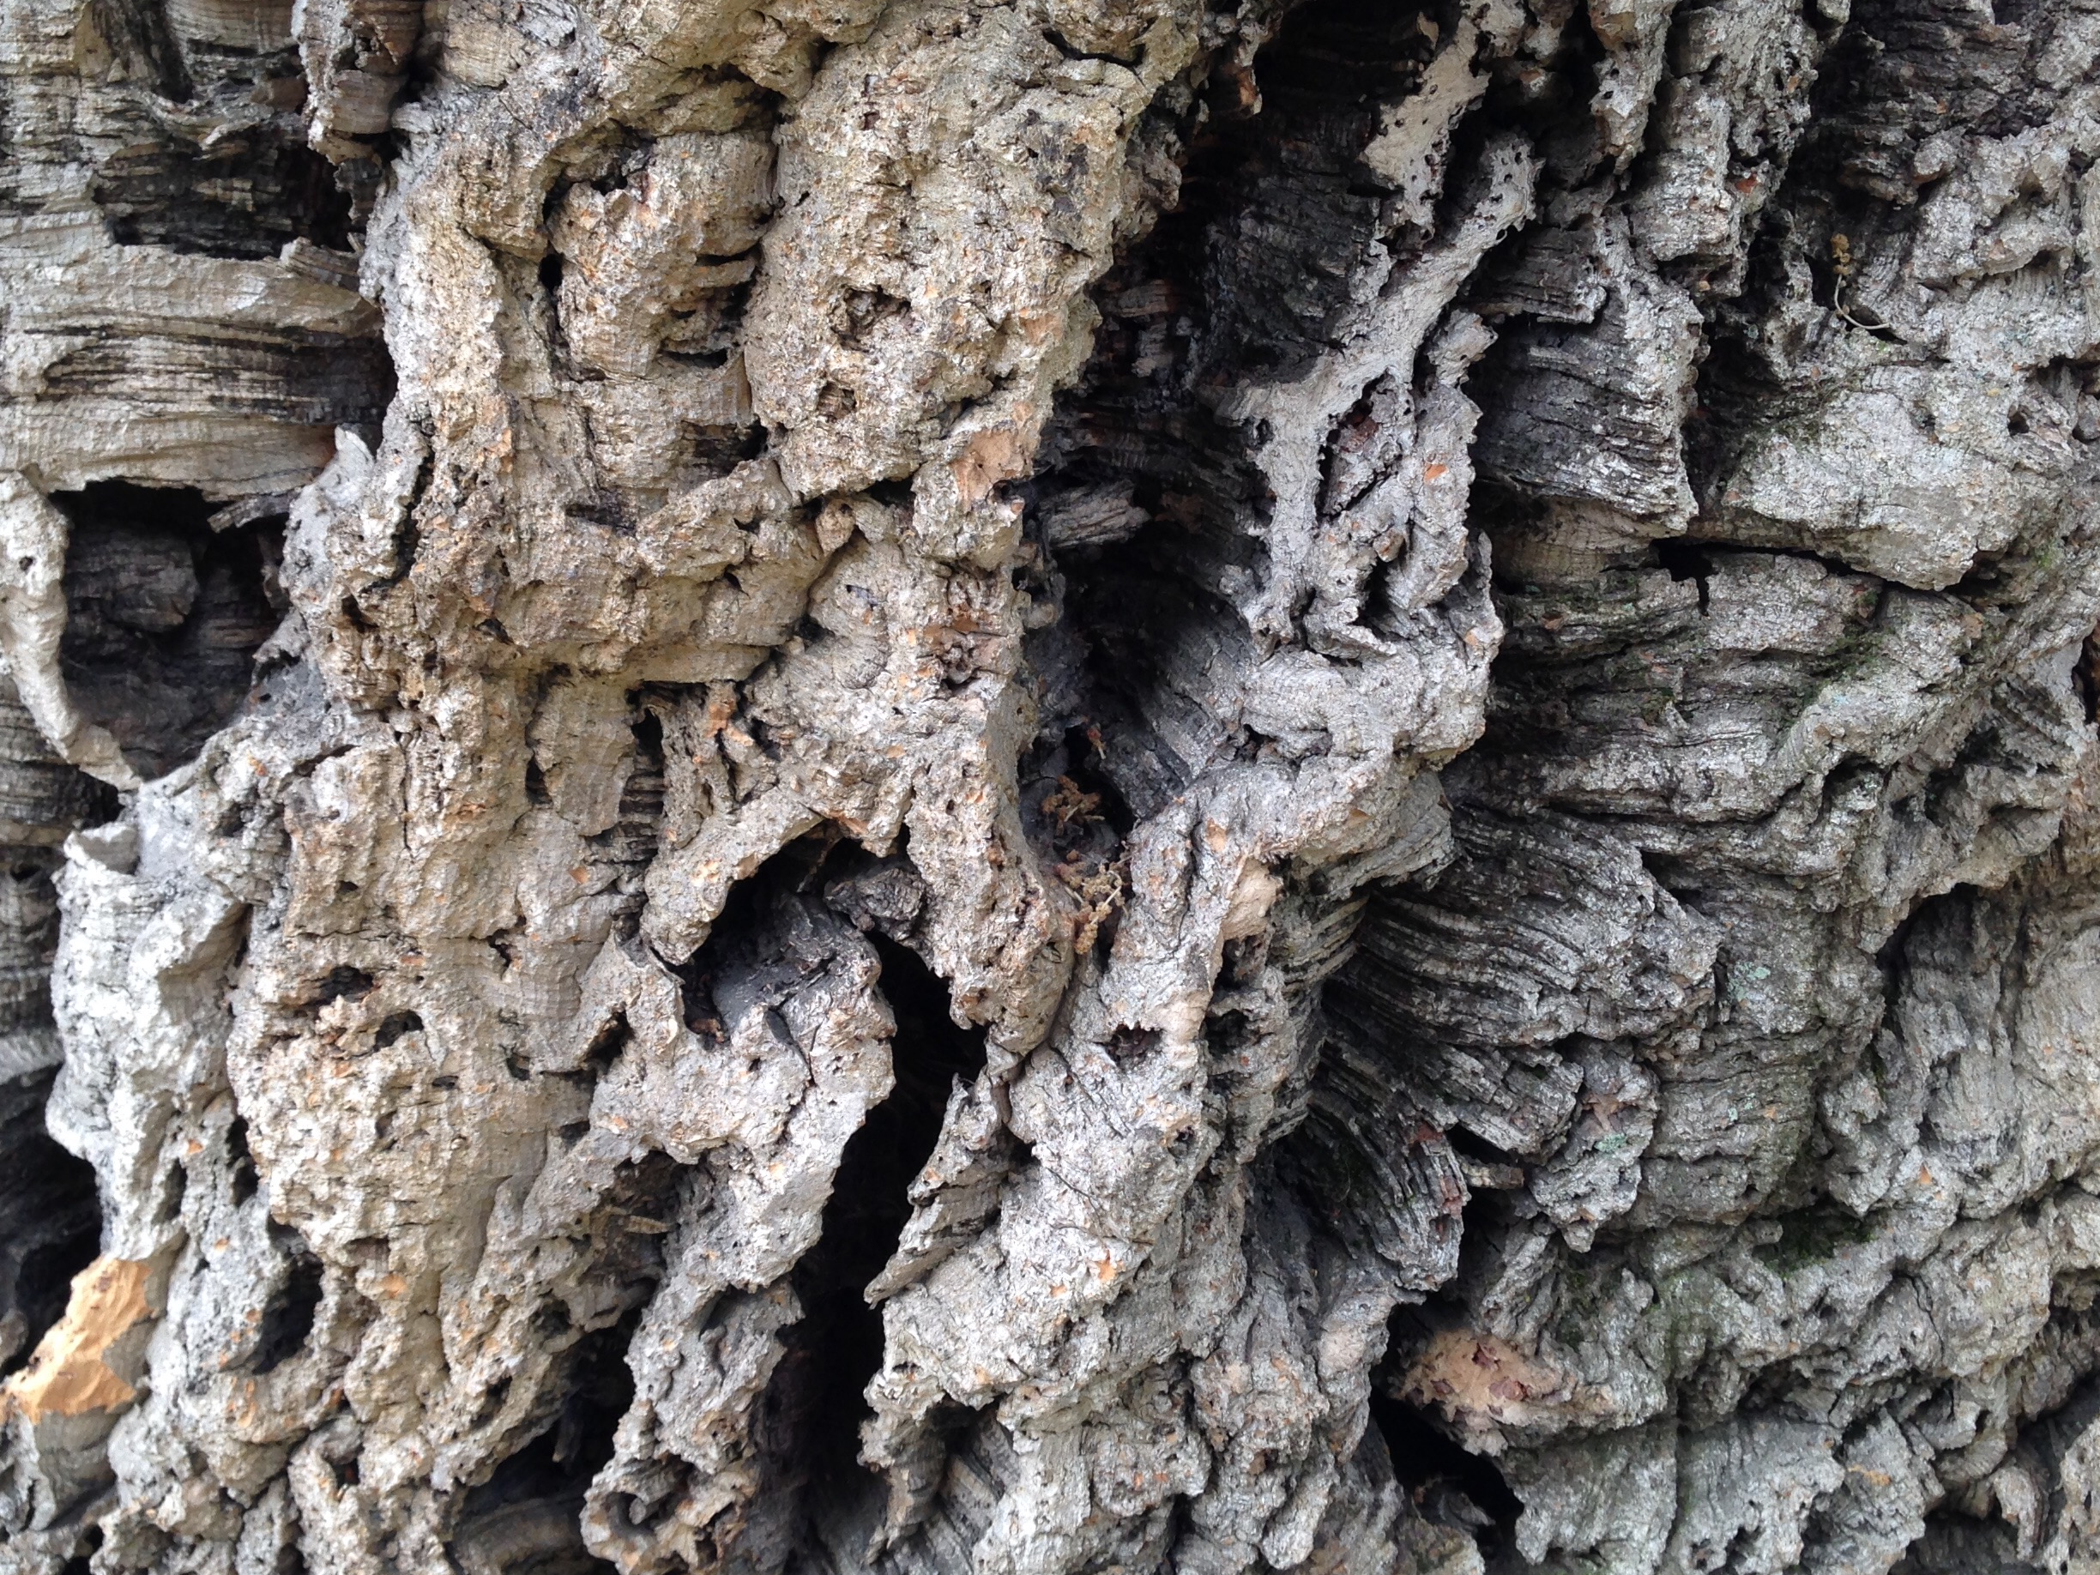

Slide 32


Slide 33
(⍺⍺ ⍵) ⍵⍵⌸ ⍵

Slide 34
[P]articipants strongly preferred to use set and subset expressions or plurals, to specify the operations in aggregate. -- Pane, 2001

Slide 35
Transparency over Abstraction

Slide 36
Pascal is for building pyramids.... Lisp is for building organisms.... It is better to have 100 functions operate on one data structure than to have 10 functions operate on 10 data structures. As a result the pyramid must stand unchanged for a millennium; the organism must evolve or perish. -- SICP

Slide 37
Abstraction Considered Harmful

Slide 38
Directness

Slide 39
One of Hix and Hartson’s usability guidelines is to Use Cognitive Directness (1993, p. 38), which means to “minimize the mental transformations that a user must make. Even small cognitive transformations by a user take effort away from the intended task.” Conventional programming languages require the programmer to make tremendous transformations from the intended tasks to the code design. -- Pane, 2001

Slide 40
Idioms over Libraries

Slide 41
I also must confess to a strong bias against the fashion for reusable code. To me, "re-editable code" is much, much better than an untouchable black box or toolkit. I could go on and on about this. If you’re totally convinced that reusable code is wonderful, I probably won’t be able to sway you anyway, but you’ll never convince me that reusable code isn’t mostly a menace. -- Donald Knuth, Interview with Andrew Binstock

Slide 42
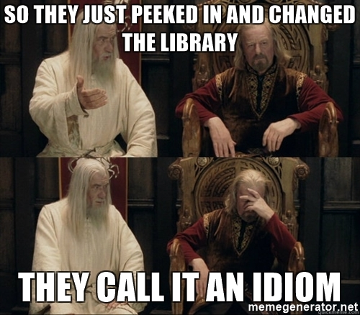

Slide 43
∧.=

Slide 44
∧.(=∨0=⊢)

Slide 45
Data over Control Flow

Slide 46
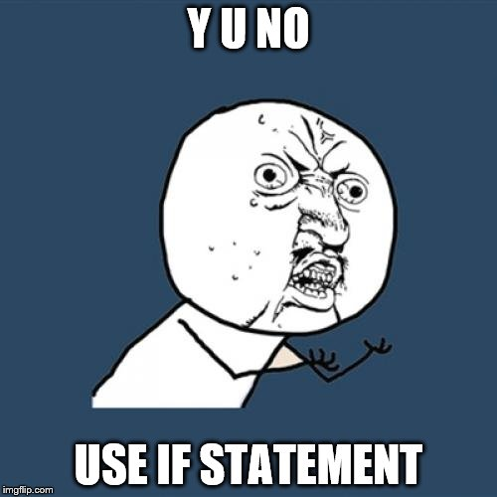

Slide 47
⊢ (⌿⍨) (+\ 1 = d) (~ ⊣ ∊ ⊣ (/⍨) (1 = d) ∧ (~ 'b' ∊⍨ k) ∧ O_{m} ∨ F_{m}) ⊢

Slide 48
[O]ne reason Miller's subjects may have not used many control statements is that they presumed that the instructee would possess a modicum of "common sense" and thus thought control statements were obvious. -- Galotti, 1985

Slide 49
Normal Folk in studies…

Slide 50
Time for Common Sense?

Slide 51
Structure over Names

Slide 52
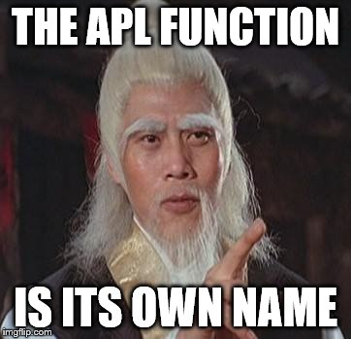

Slide 53
“Good Variable Names”

Slide 54
primeNumbersBetween

Slide 55
(2=+⌿0=X∘.|X)/X←⍳N

Slide 56
(~X∊X∘.×X)/X←2↓⍳N

Slide 57
Idiomatic Style/Structure

Slide 58
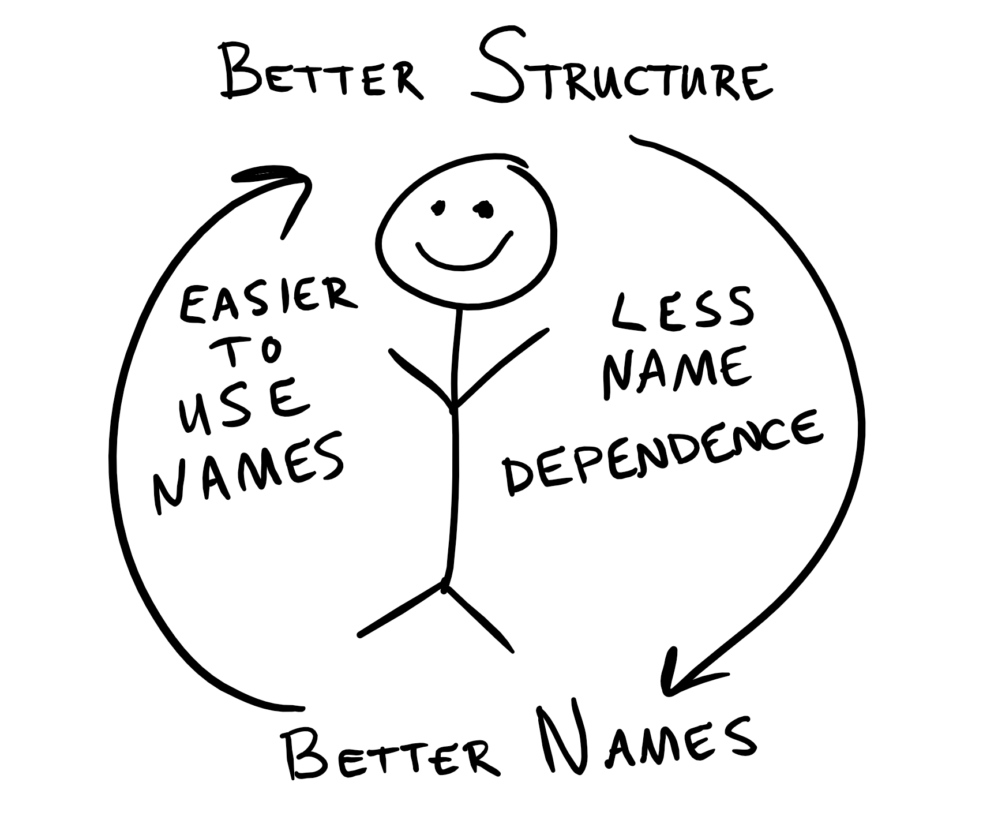

Slide 59
What’s in a name? Everything.

Slide 60
The aggregate operations preferred by the participants reduce the need for these variables, which are another known area of difficulty for beginners (du Boulay, 1989). -- Pane, 2001

Slide 61
Implicit over Explicit

Slide 62
Fuzzy

Slide 63
Suggestive Generality

Slide 64
Serendipitous Transfer

Slide 65
[The] implication for programming of this latter interpretation…is that there may be serious "cognitive mismatches" between the solutions provided by naive programmers intended for other people and the solutions required for effective computer programming. -- Miller, 1981 [I]t is bad form to belabour the obvious. -- Galotti, 1985

Slide 66
Syntax over Semantics

Slide 67
Human-centered

Slide 68
Reliance on the Machine vs. Empowering the Mind

Slide 69
multiply←{ cube ← {⍵⍴⍨2⍴⍨2⍟≢⍵} roots ← {¯1*(⍳⍵)÷⍵} butterfly← {(⊣/⍺)∇⍣(×r)⊢(+⌿⍵),[r-0.5]⍺×[⍳r←≢⍴⍺]-⌿⍵} FFT ← { ,(cube roots 2÷⍨≢⍵) butterfly cube ⍵} IFT ← {(≢⍵)÷⍨,(cube +roots 2÷⍨≢⍵) butterfly cube ⍵} m←2*⌈2⍟¯1+(≢⍺)+≢⍵ IFT (FFT m↑⍺) × (FFT m↑⍵) ⍝ ←→ (m↑⍺) ×⍢FFT (m↑⍵) }

Slide 70
Aesthetics Matter

Slide 71
Prefer Beauty over Rigor

Slide 72
Demand Simplicity

Slide 73
Eliminate the Need for Language Features

Slide 74
Optimize for Rewrite

Slide 75
Myth of Readability

Slide 76
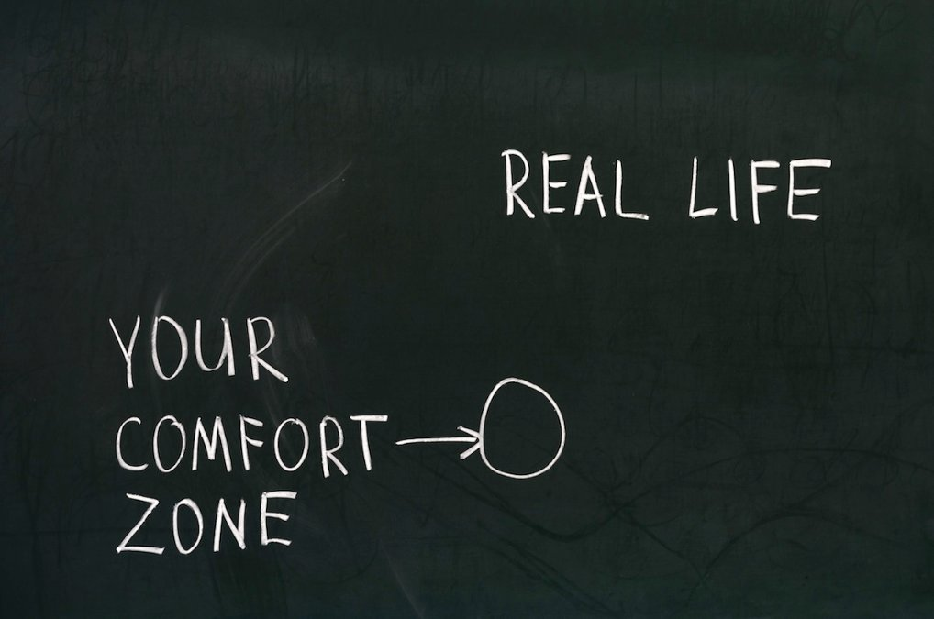

Slide 77
Comprehension

Slide 78
Readability Bet

Slide 79
Readability is human, not mechanical.

Slide 80
APL Practice
Accepted Practice
Brevity
Macro
Transparency
Idioms
Data
Structure
Implicit
Syntax
Verbosity
Micro
Abstraction
Libraries
Control Flow
Names
Explicit
Semantics

Slide 81
You can do it!

Slide 82
Thank You. http://r.sacrideo.us/apl-patterns http://www.github.com/arcfide/Co-dfns http://www.tryapl.org

